Slide 1
Sun RPC
also called ONC (Open Network Computing) RPC
originally designed for client-server communication for Sun Network File System (NFS)
provides an RPC interface language called XDR and compiler called rpcgen
uses “at-least-once” call semantics
can use either UDP of TCP transport service

Slide 2
Sun RPC Interface Definition Language
XDR was originally designed for specifying eXternal Data Representation
XDR has been extended to become Sun RPC IDL
an interface contains a program number, version number, procedure definition and required type definitions
a procedure definition specifies a procedure signature and a procedure number
Only a single input and output parameters are allowed
  these parameters can be a structure containing multiple elements

Slide 3
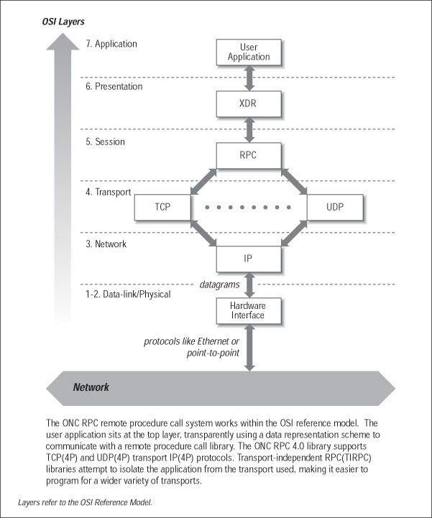
Sun RPC within the OSI Reference Model

Slide 4
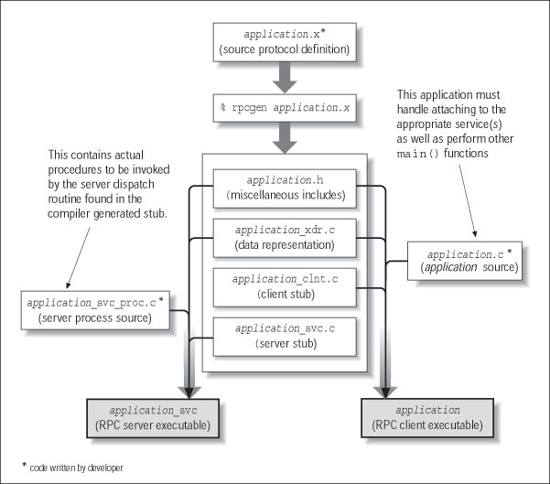
Developing Client-Server Application using Sun rpcgen

Slide 5
Example: Files interface in Sun XDR
/* FileReadWrite service interface definition in file FileReadWrite.x */
const MAX = 1000;
typedef int FileIdentifier;
typedef int FilePointer;
typedef int Length;
struct Data {
int length;
char buffer[MAX];
};
struct writeargs {
FileIdentifier f;
FilePointer position;
Data data;
};
struct readargs {
FileIdentifier f;
FilePointer position;
Length length;
};
program FILEREADWRITE {
version VERSION {
void WRITE(writeargs)=1;
Data READ(readargs)=2;
}=2;
} = 9999;

Slide 6
C program for server procedures in Sun RPC
/* File S.c – server procedures for the FileReadWrite service */
#include <stdio.h>
#include <rpc/rpc.h>
#include “FileReadWrite.h”
void *write_2(writeargs *a)
{
/* do the writing to the file */
}
Data *read_2(readargs *a)
{
static Data result; /* must be static */
result.buffer = … /* do the reading from the file */
result.length = … /* amount read from the file */
return &result;
}

Slide 7
C program for client in Sun RPC
/* File C.c – Simple client of the FileReadWrite service. */
#include <stdio.h>
#include <rpc/rpc.h>
#include “FileReadWrite.h”
main(int argc, char **argv)
{
CLIENT *clientHandle;
char *serverName = “coffee”;
readargs a;
Data *data;
clientHandle = clnt_create(serverName, FILEREADWRITE,
VERSION, “udp”); /* creates socket and a client handle */
if (clientHandle==NULL){
clnt_pcreateerror(serverName); /* unable to contact server */
exit(1);
}
a.f = 10;
a.position = 100;
a.length = 1000;
data = read_2(&a, clientHandle); /* call to remote read procedure */
…
clnt_destroy(clientHandle); /* closes socket */
}

Slide 8
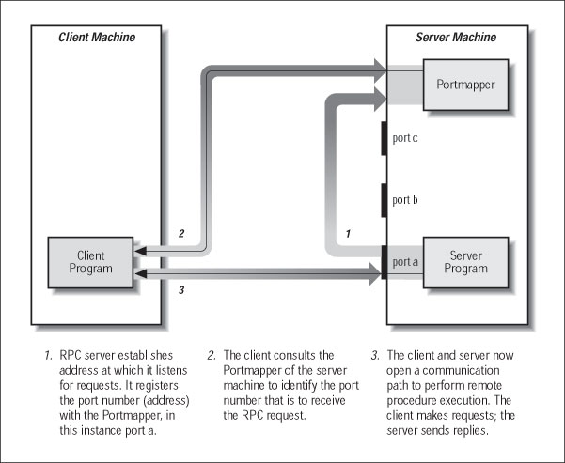
Sun RPC Binding
Sun RPC does not have a network-wide binding service
provides a local binding service called the portmapper which runs on every computer
the client must specify the hostname of the server as well as the program number and version number

Slide 9
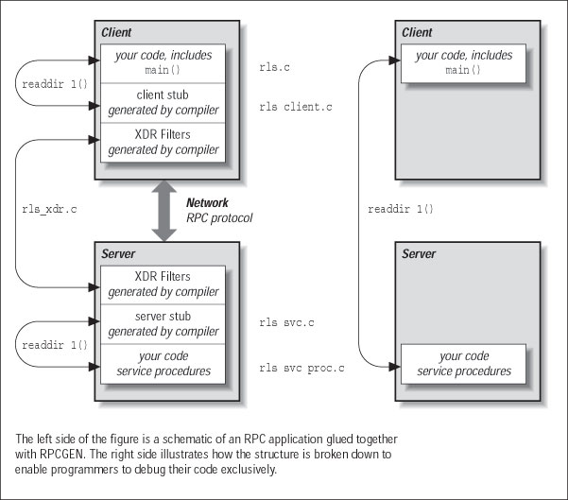
Debugging Sun RPC
Client & server code should be able to compile and run on a single machine (via local procedure call)

Slide 10
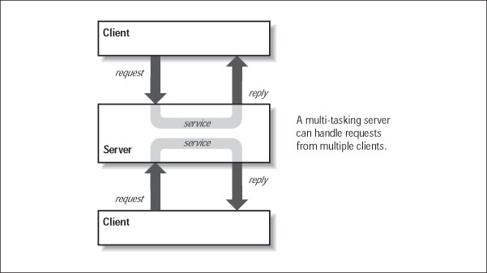
A Multi-tasking Server

Slide 11
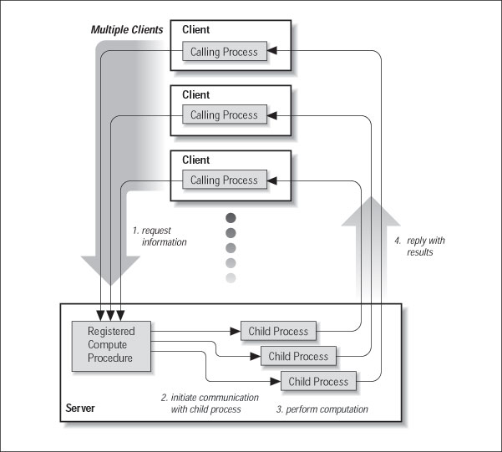
Server Multi-tasking via Multiple Processes

Slide 12
Sun RPC Lower-Level Facilities
Null RPC to test whether a server is running (similar to host ping)
broadcast RPC possible to send RPC to all instances of a service in a LAN
batching of client calls that require no reply
authenticated calls supported (uid and gid included as parameters for UNIX authentication)

Slide 13
Sun RPC Example - Hello World Application
Hello World Interface Definition
/* file - hello.x */
program HELLO_PROG {
version HELLO_VERS {
int HELLO(string) = 1;
} = 1;
} = 0x200000001;

Slide 14
Hello World Server Code
/* file - hello_svc_proc.c */
#include <stdio.h>
#include <ctype.h>
#include <rpc/rpc.h>
#include “hello.h”
int *hello_1(ppName)
char **ppName;
{
int rc;
printf(“Hello %s\n”, *ppName);
rc = 0;
return((int *) &rc);
}

Slide 15
Hello World Client Code
/* file - hello.c */
#include <stido.h>
#include <rpc/rpc.h>
#include “hello.h”
#define HOSTNAME=“fraser”
main(argc, argv)
int argc;
char *argv[];
{
CLIENT *client_handle;
int rc;
char *pMyName;
if (argc ==2)
pMyName = argv[1];
else {
printf("Usage: argv[0] your_name\n");
exit(1);
}
if (!(client_handle = clnt_create(HOSTNAME,
HELLO_PROG< HELLO_VERS, “tcp”))) {
clnt_pcreateerror(HOSTNAME);
exit(1);
}
rc = *hello_1(&pMyName, client_handle);
exit(0);
}

Slide 16
More on Sun RPC
Sun RPC man pages and examples can be found in
the /afs/p/class/cse/cs600/Sun_RPC directory

